Slide 1
CSC 101 – Introduction to Computing
Lecture 05

Slide 2
Number system Addition and Subtraction
Binary addition and subtraction
Octal addition and subtraction
Hexadecimal addition and subtraction

Slide 3
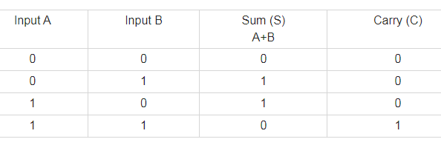

Slide 4
0101 + 1000
1101
1010 + 0011
1101
1010 + 1110
1 1000

Slide 5
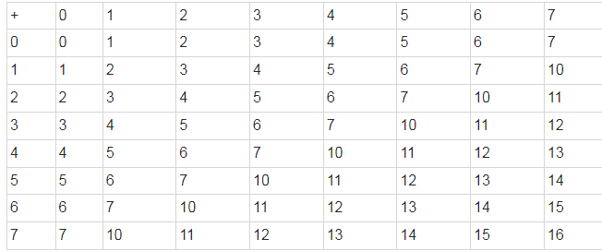
Octal Addition

Slide 6
642 + 321
1 163
146 + 136
304

Slide 7
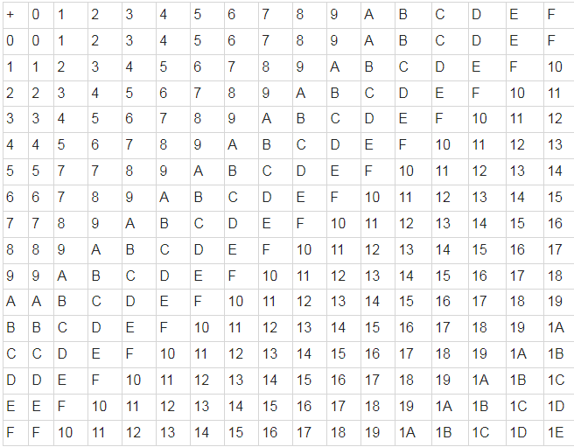
Hexadecimal Addition

Slide 8
8AB + 93C
1 1E7
899 + 189
A22
DAF+BAF
195E

Slide 9
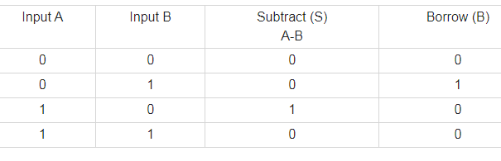

Slide 10
Binary Subtraction
1101 – 0111
0110
1010010 – 111111
0010011
100001 – 1111
010010

Slide 11
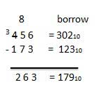
Octal Subtraction
456 – 173
= 263
743 – 564
=157
624 - 265
337

Slide 12
Hexadecimal Subtraction
9654 - 5321
4333
974B – 587C
3ECF

